Slide 1
Optimization of Li-ion battery design
Raghav Agarwal, Hirbod Akhavan, Kenton Cuddington

Slide 2
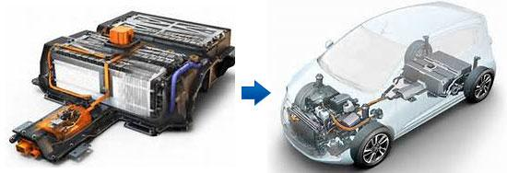
Motivation
Development of alternate energy storage systems for transportation use, storing solar energy and powering electronic gadgets such as mobile phones, laptops and tablets has been driven by a combination of environmental preservation, fossil fuel price volatility and energy security concerns. Lithium-ion battery has emerged as a favored choice, however its energy density is still orders of magnitude lower than that fossil fuel. There is significant room for improvement in the battery cell.

Slide 3
Battery design variable optimization can significantly affect battery capacity, discharge specific power, and discharge specific energy. However, many design variables need to be taken into consideration, which requires intensive computation and simulation.
The main motivation for using this Li ion battery technology is the fact that lithium is the lightest and most electropositive metallic element, and therefore facilitates very high energy density. Additionally, it is quickly becoming the industry standard for electronic devices

Slide 4
Objective
The objective of this project is to
Maximize the energy density of the Lithium ion battery
Allows for delivering power over a longer period of time without recharging the cell.
Minimize the maximum temperature in the cell to increase expected life.
Will help prevent thermal runaway, combustion and overheating of the battery at high voltage, which are currently principal concerns of using li-ion cells in certain applications.
These are conflicting objectives since to increase energy density, thickness of electrode needs to be reduced while porosity needs to increase. For thermal, the opposite is needed.

Slide 5
Structure of Li-ion cell
Every cell has in some form these 5 components: 2 electrodes, a separator, a current collector and an electrolyte.
These layers are rolled into a cylinder and enclosed in a casing.
A reduction–oxidation (redox) reaction is responsible for the current flow. This reaction along with ohmic heating is responsible for the internal heat generation which accors at the anode and cathode.
The anode is the electrically negative electrode delivering electrons to the outside circuit, and the cathode is the electrically positive electrode.

Slide 6
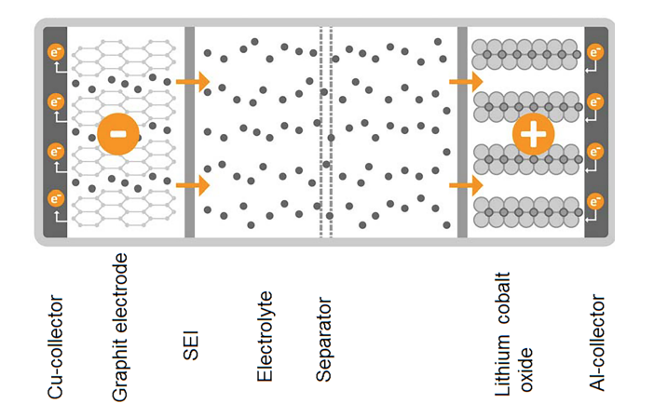
Structure of Li Ion Cell

Slide 7
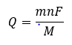
Variables, Parameters, and Objective
Variables:
X₁: anode thickness.
X₂: cathode thickness.
X₃: anode porosity.
X₄: cathode porosity.
Objective:
Minimize T at center pin(location where maximum temperature occurs).
Maximize specific energy density, knowing that Faraday’s law states
m = mass of an element transferred during electrolysis
n = valency of the element
M = molar mass of the element
F = Faraday’s Constant

Slide 8
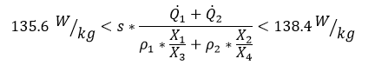
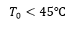
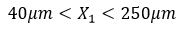
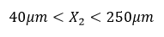

Constraints
Power density needs to be maintained at this range to prevent accelerated degradation [1]
Maximum operating temperature of the cell.
Anode and Cathode thicknesses need to stay within a range to permit li-ion cell usage [2]
Anode and Cathode porosity need to stay within a range to ensure proper functioning of li-ion cell [2]

Slide 9
Initial Optimization Formulation and Assumptions
Assumptions:
Separator layer has a zero thickness and infinite coefficient of thermal conductivity.
K₁ and K₂, the thermal conductivity of the anode and cathode, are not a function of X₁ and X₂.
The number of layers of anode and cathode, S, must be the same.

Slide 10
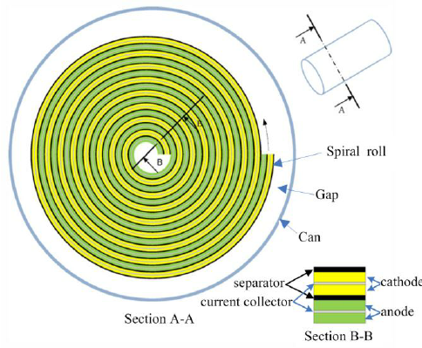
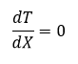
Formulation: Thermal Performance
Center pin modeled as insulated wall
T₀
Q̇1
Q̇1
Q̇2
Q̇2
T∞,h
X₁
C
X₂
X
T=T₁
This pattern is repeated S times

Slide 11
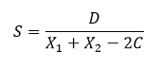
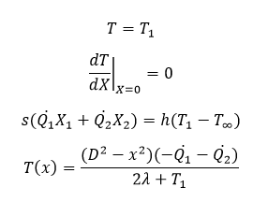
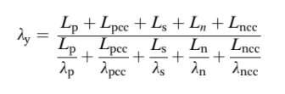
Formulation: Thermal Performance
D is the diameter of the cell.
Boundary Conditions:
𝞴 is the equivalent thermal conductivity. s(separator), cc(current collector), n(negative), p(positive)
Center pin modeled as insulated wall
T₀
Q̇1
Q̇1
Q̇2
Q̇2
T∞,h
X₁
C
X₂
X
T=T₁

Slide 12
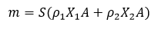
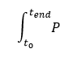
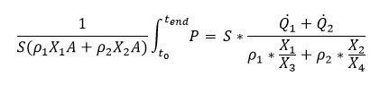
Specific Energy Density
Mass Of the Cell
Total Energy Stored
Specific Energy Density [1]

Slide 13
Plan for next steps
Further Refine the Objective Functions
Formulate more explicit governing equations for the thermal processes involved
Research areas where the thermal and electrochemical processes interact
Further Define Our Constraints
Relate the electrochemical and thermal processes
Remove redundant variables if there are any
Simplify The Problem Where Needed

Slide 14
References
[1] Kim, J., Lee, D., Lee, J. et al. Optimization for maximum specific energy density of a lithium-ion battery using progressive quadratic response surface method and design of experiments. Sci Rep 10, 15586 (2020). https://doi.org/10.1038/s41598-020-72442-4
[2] Xue, N. et al. Optimization of a single lithium-ion battery cell with a gradient-based algorithm. J. Electrochem. Soc. https://doi.org/10.1149/2.036308jes (2013).

